Slide 1
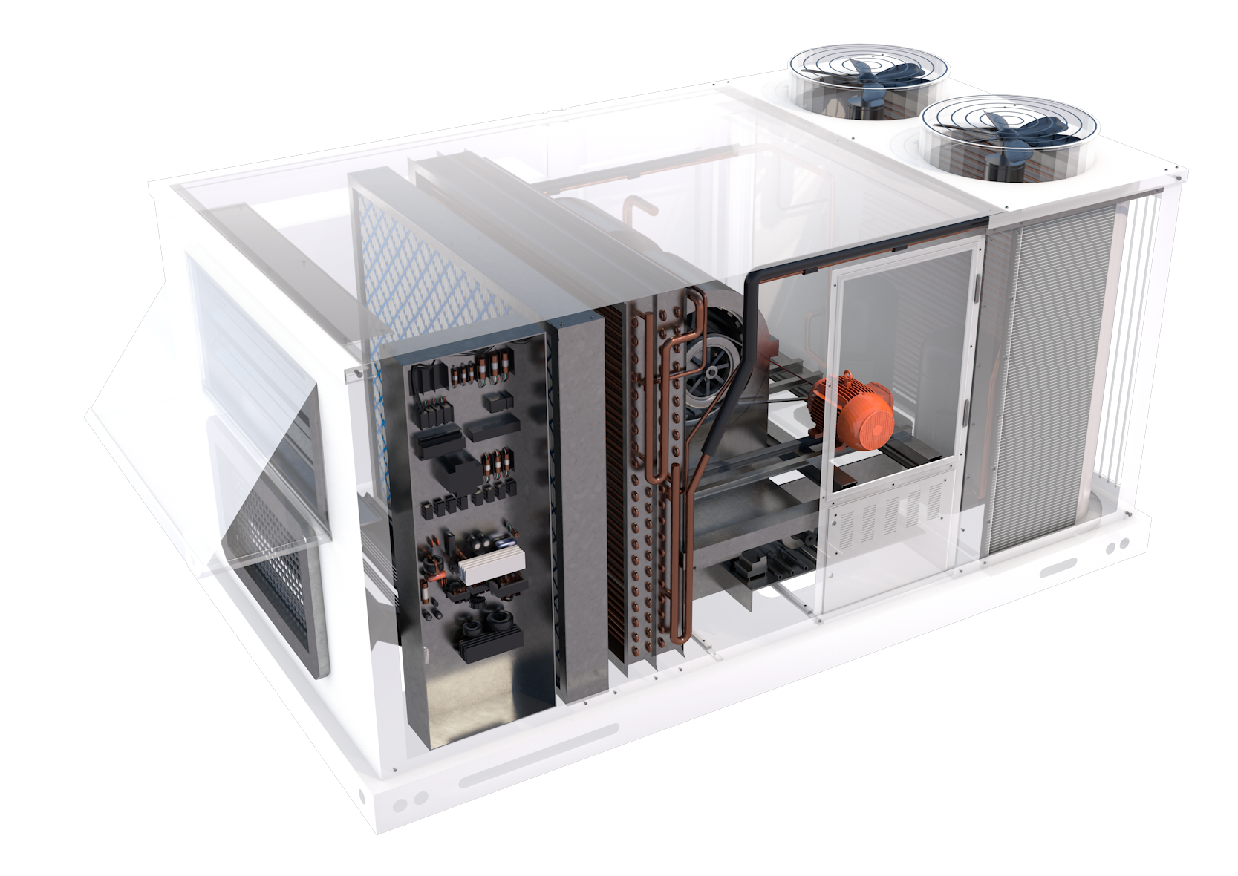
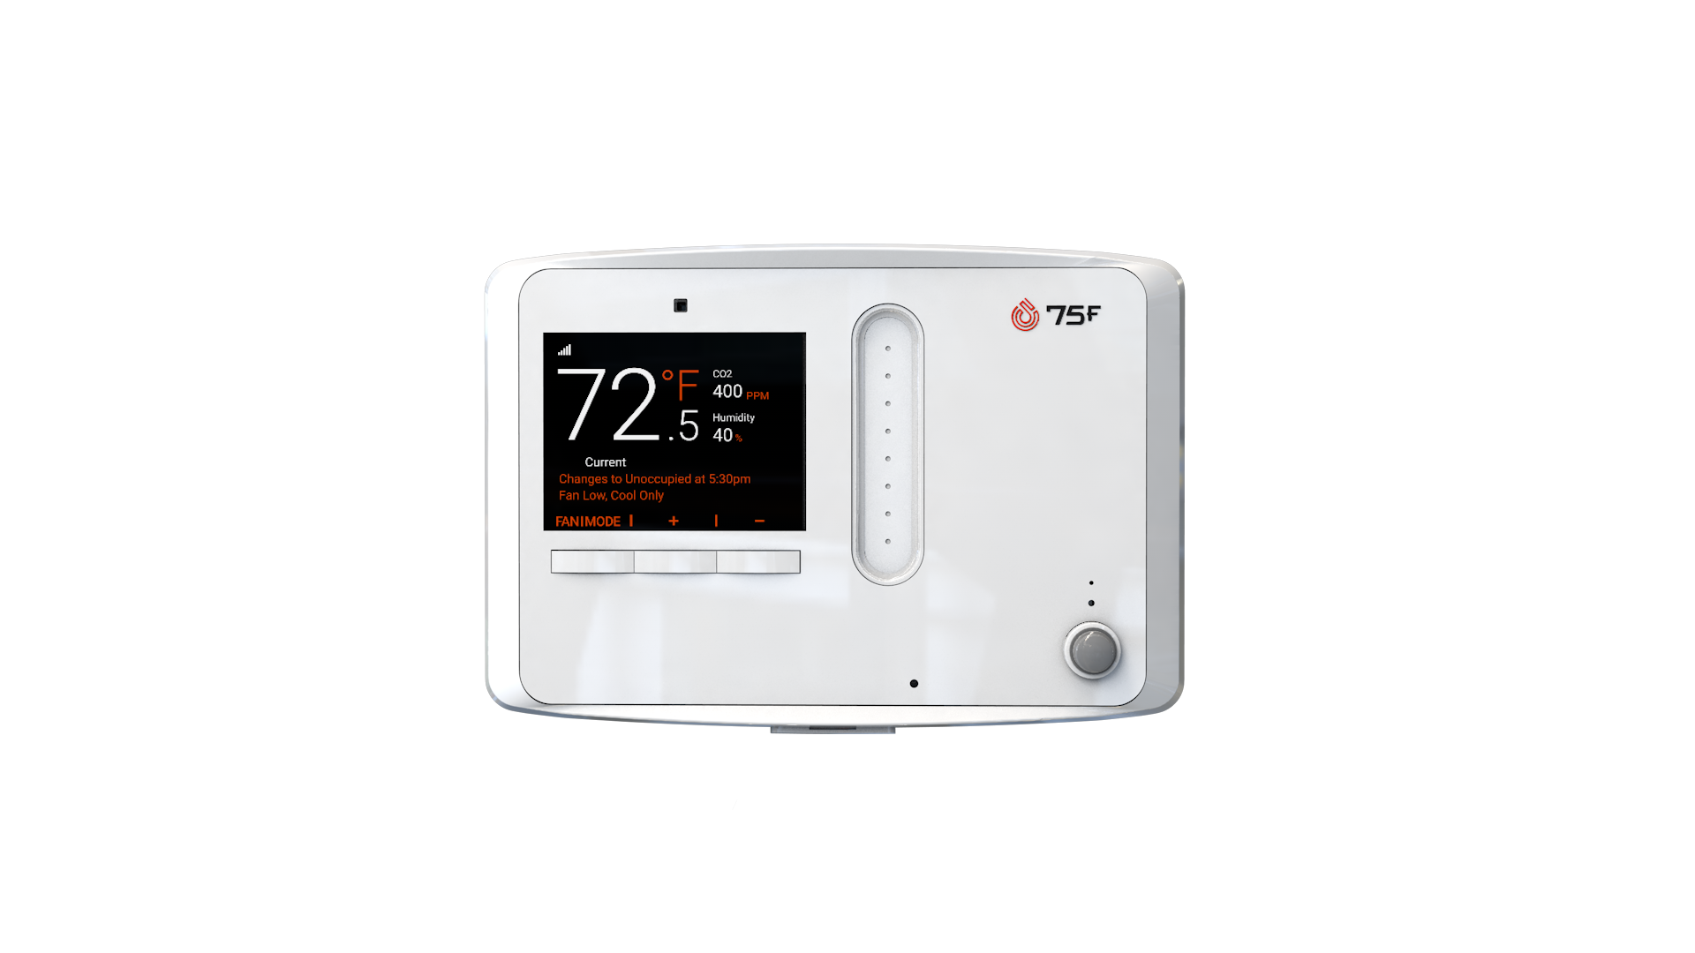
SPEC SHEET
75F® HyperStat Split
Advanced Rooftop Controls Over Two Wires
Standard 18/2 Thermostat Wire
Dual enthalpy economizer, demand-control ventilation (DCV), and variable frequency drive (VFD) control
(7) Onboard sensors for occupancy, temperature, light, humidity, sound, CO2 & optional particulate matter
(8) Relays
(4) Analog outputs
(8) Universal Inputs
BACnet and Modbus control
1
724-276-3035 | Support@Airoverse.com | Airoverse.com

Slide 2
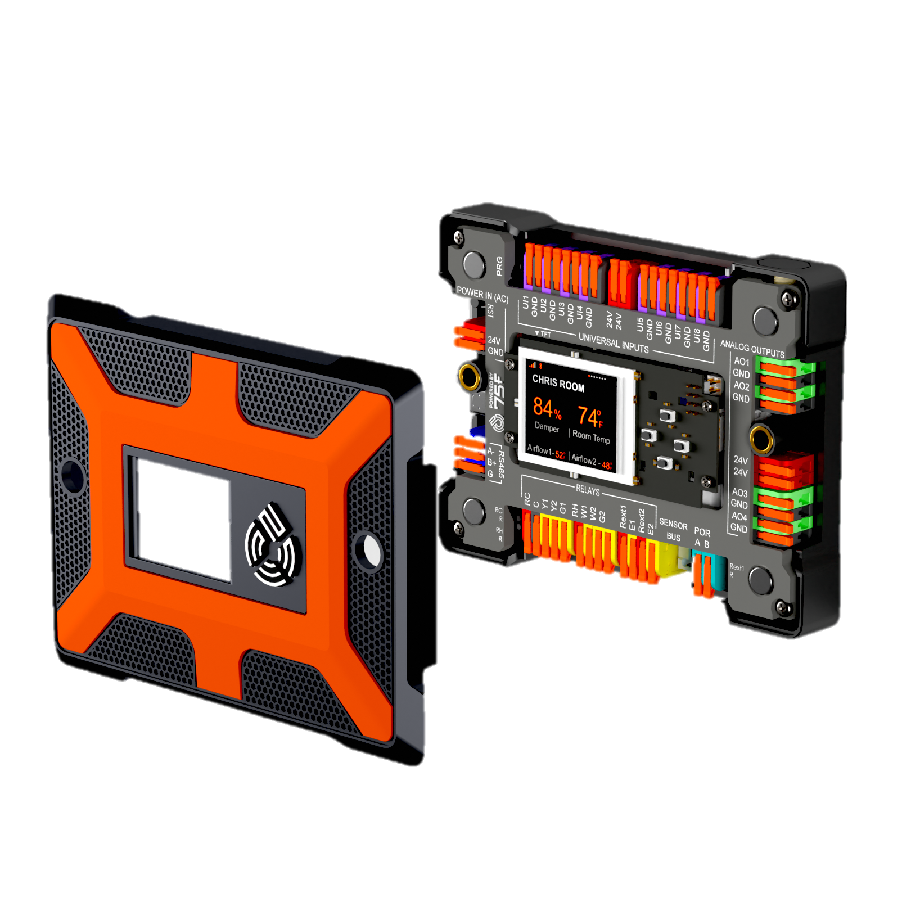
75F® HyperStat Split
The HyperStat Split empowers contractors to upgrade rooftop units with Advanced Rooftop Control with unprecedented ease, bringing energy efficiency to more buildings than ever before. Using only two existing wires from the RTU to the thermostat, the HyperStat Split provides dual enthalpy economizer, demand-control ventilation, and VFD control. An onboard PIR occupancy sensor enhances energy savings with auto away, and its hefty I/O package enables alerts like condensate overflow and dirty filters.
OVERVIEW
ADDITIONAL FEATURES
The HyperStat Split facilitates ARC over the existing two wires in retrofit applications using a HyperLite and a Connect Module. Both an occupant interface and a powerful indoor air quality sensing station, the HyperLite takes user input and collects data on temperature, humidity, light, sound, CO2, occupancy, and particulate matter. The Connect Module communicates with the HyperLite over two wires from the RTU or FCU and performs stage or modular control. With the ability to accept eight universal analog inputs, the back half of the Connect Module moves load control away from the zone.
Over-the-air firmware updates
Works over the two wires provided for the thermistor to report temperature to the RTU
Plug-and-Play solution for Advanced Rooftop Control
EQUIPMENT CONTROL
Up to three stages of cooling/heating/fan or fully modulating:
Rooftop Units
Unit Heaters
KEY FEATURES
Dual enthalpy economizer, demand-control ventilation, and VFD control for full Advanced Rooftop Controls over two wires
Condensate overflow and dirty filter sensors with notifications for advanced alerts
Real-time access to sensor data and remote control over building parameters through Facilisight, 75F’s building intelligence suite of web and mobile apps
Secure and proprietary encrypted 900 MHz wireless mesh network allows for lightweight, reliable communications between devices, eliminating the need to run wires throughout a space
INCLUDED
(1) Each of HyperLite and Connect Module
(1) Mounting Adapter Plate
(2) Mounting Screws
2
724-276-3035 | Support@Airoverse.com | Airoverse.com

Slide 3
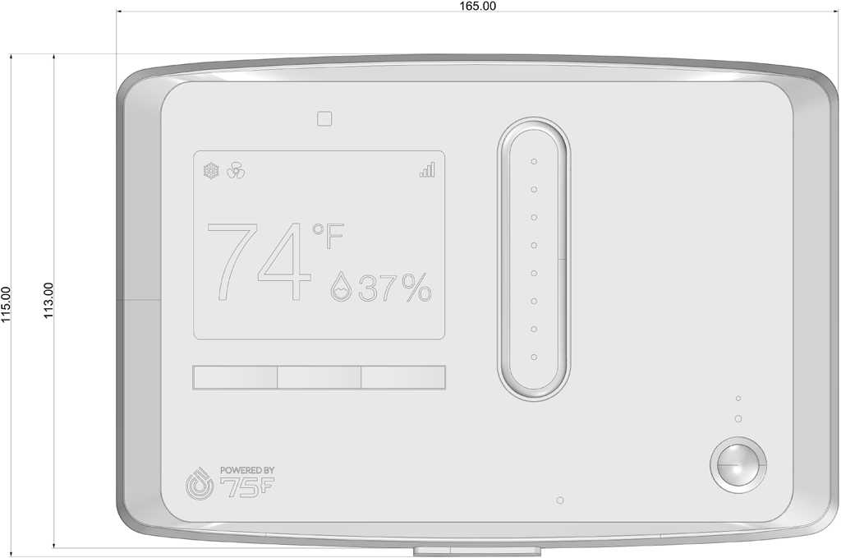
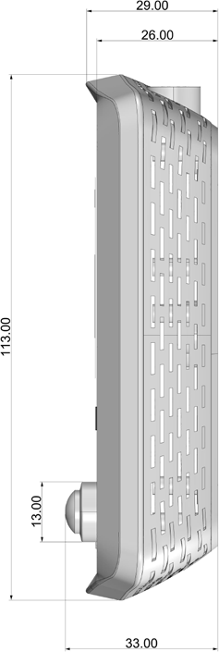
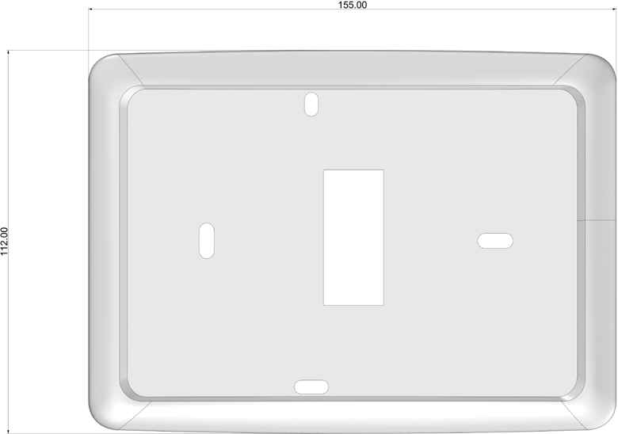
75F® HyperLite
165mm
MECHANICAL
Dimensions
6.5” x 4.5” x 1.15” (165mm x 115mm x 29 mm)
115mm
113mm
Mounting
(2) screws in drywall
Screen
2.8” 240x320 pixel TFT LCD
Operating Range
-4°F to 122°F (-20°C to 50°C)
SENSORS
ELECTRICAL
Temperature
Operating range between -4°F to 122°F (-20°C to 50°C); typical accuracy of +/- 1°F or 0.2°C
Power
24V AC/DC (+/-15%) with nominal
power consumption 1.0W and maximum consumption of 2.5W
Humidity
Operating range between 20 to 85% noncondensing; Typical accuracy of +/- 2% RH
COMMUNICATIONS
Dedicated
CO₂ Sensor
Range 0-40’000 ppm; Accuracy +/-30ppm over range of 400-10,000ppm and lifetime of 15 years
Bluetooth
BLE4.1; used during commissioning
Mesh
900 MHz IEEE 802.15.4-compliant; used for device communication on mesh network
Light
Ambient light sensor; high-accuracy UV index sensor; matches erythemal curve; < 100 mix resolution
Wired
4 wire RS-485 interface
3 wire connector for low-power sensor bus
Sound
40-120dB response for 100 Hz to 10Khz
Occupancy
Passive Infra Red (PIR) with detection
range of 4m with 30-degree angle
29mm
155mm
OPTIONAL SENSORS
PM2.5, PM10
Detection range of
0-1000ug/m3 and accuracy of +/-
10ug/m3 (PM2.5, 0-100 ug/m3) or
+/- 25ug/m3 (PM10, 0-100ug/m3)
113mm
112mm
3
724-276-3035 | Support@Airoverse.com | Airoverse.com

Slide 4
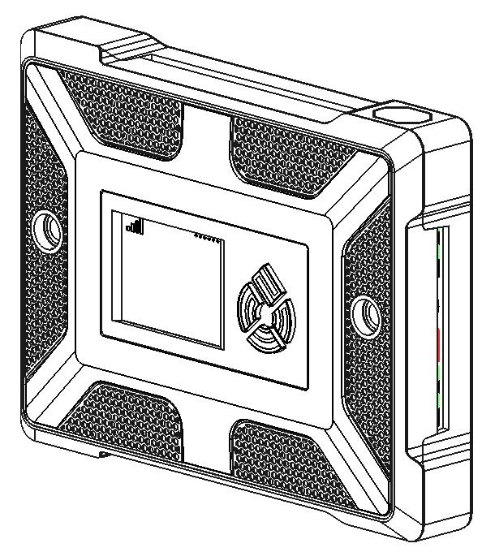
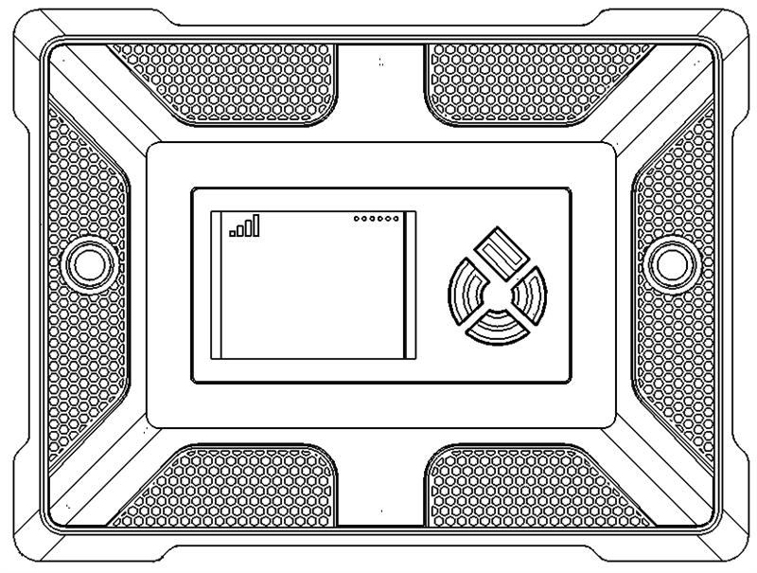
75F® Connect Module
MECHANICAL
Dimensions
5.5” x 4.13” x 1.22” (140 mm x 105 mm x 31mm)
Mounting
Wall
Screen
TFT LCD, 1.77", 128(RGB)* 160 Pixels
140
31
105
COMMUNICATIONS
I/O
Bluetooth
Bluetooth – Available for future use.
Inputs
(8) Universal inputs.
(1) Sensor Bus
Wired
Modbus RTU / BACnet over RS485 communication
Sensor bus
Power over RS485 to enable communication with the HyperLite and power the unit over standard thermostat wires.
Dedicated Modbus/BACnet MSTP ports to interface with 3rd party BMS devices.
Outputs
(4) 0-10V dc or 4-20mA analog outputs
(8) relays rated at 1A, 120V ac or 24 V ac/dc resistive load
ELECTRICAL
Power
24V AC/DC (+/-15%) with nominal
power consumption 1.0W and maximum consumption of 2.5W
4
724-276-3035 | Support@Airoverse.com | Airoverse.com

